Slide 1
Brahmaputra Hostel
Idea submission!

Slide 2
Motivation
Canteens and Juice Centres are lifeline of student fraternity in campus as mess food is highly dreading. Despite their such huge importance, till now no efforts are made for their smooth functioning.
Thus, we present first ever platform for students and shop managers to ease out exchanges between them.
Aiming to ensure a hassle free, convenient and time saving platform for both the users and the shop managers. Avoiding a tussle between the students and the managers is one of our main motives.

Slide 3
Problems
The conventional way of ordering at canteens and juice centres suffer from many problems.
It is highly inconvenient way for both students and canteen managers.
Students :-
Long Queues are unbearable.
They have to wait for a long time to get their food ready.
Sometimes wrong order is prepared instead of their order.
Managers :-
With great hustle at the counter they can’t make sure that their customers are paying them or not.
Owner of the canteen does not get exact figures of commodities sold.

Slide 4
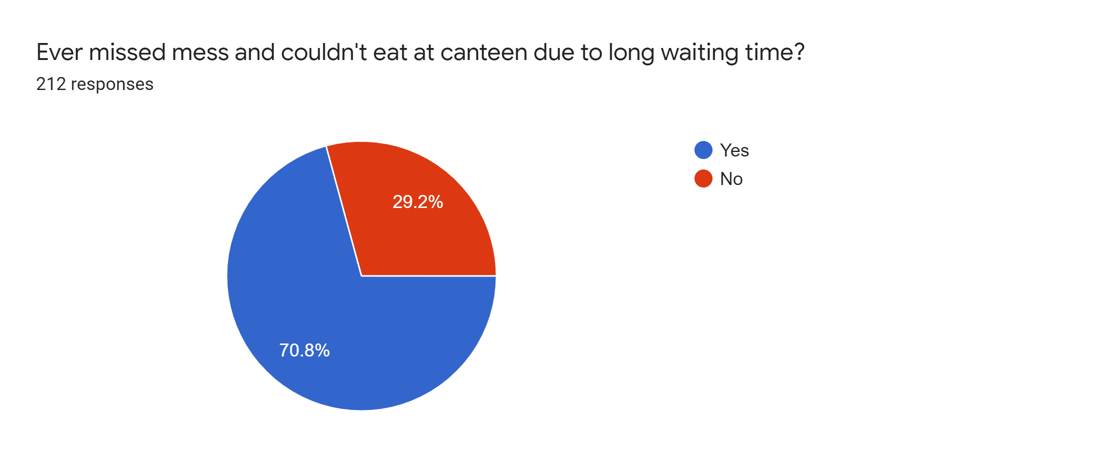
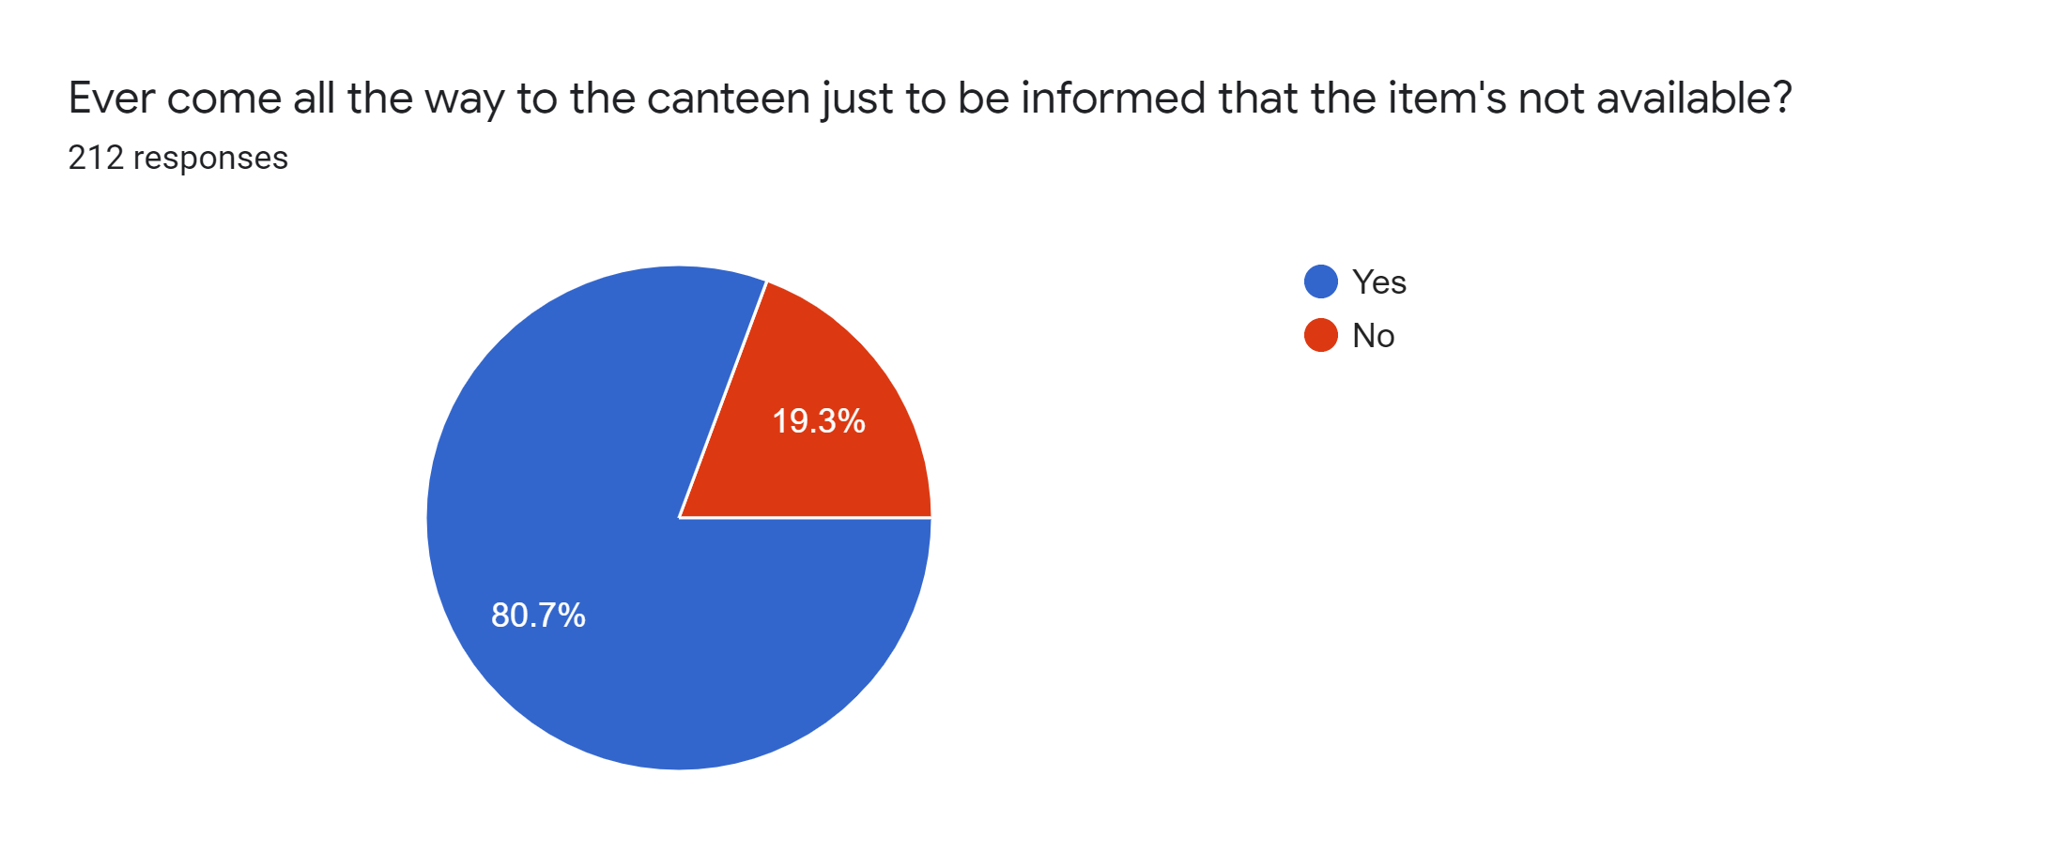
Customer Research

Slide 5
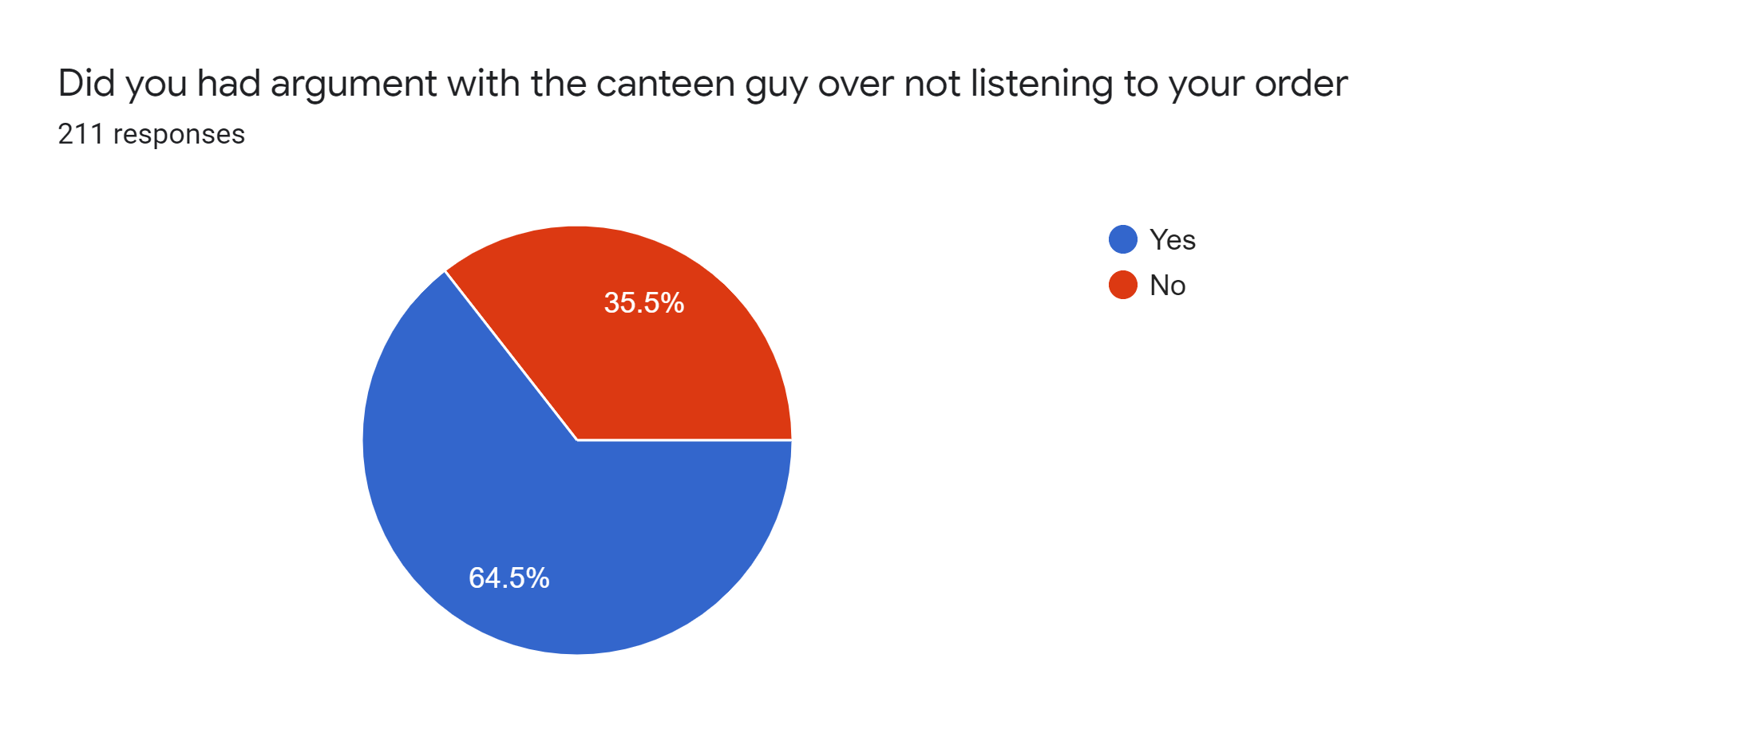

Customer Research

Slide 6
Journey of Your Food Craving
Order Using Mobile Application.
Order will be directed to the shop owners and he confirms it .
Order gets ready and seller marks it ready.
Owner can look at the sales later at any time.
Collect the order and pay the money.
User gets the notification.

Slide 7
What we have for students?

Slide 8
Time is precious, don’t waste it standing in queues of canteens or juice centres, order your food from your room and grab it when it is ready.
Don’t eat a veg sandwich if you ordered an egg sandwich, get the correct order everytime you crave for food.

Slide 9
Just sit and enjoy your food, no more standing in crowded areas and struggle to have a bite of your food.
No more yelling of orders and still not being heard. Just click and order.
We believe that nothing could be more fair than the first come first serve basis.

Slide 10
What we have for managers?

Slide 11
You know who placed an order and hence he can’t deny after food is ready. This would reduce wastage.
If the ordering process gets this easy we surely expect a boost in the sales.
We ensure that everyone pays for their order.

Slide 12
No more confusion on “who ordered what?”. Everything is there on your screen.
Keeps a track of orders and helps in ordering raw materials in advanced for more frequent orders.

Slide 13
Specific Plans for sprint
Launch our app in the Brahmaputra Hostel.
We will be operating in the peak hours.
We will do Branding of our product in Brahmaputra hostel (door to door).
According to feedback we will make necessary changes in our product.
In case of any technical glitch we have our MINIMUM VIABLE PRODUCT :- We will receive order through Whatsapp and manually place the order at canteens.

Slide 14
Thank You!
We will convince canteen owner by stating the problems mentioned in the problems section.
We will paste posters near canteens giving information regarding installation of our app.
Continuous feedback will be taken during sprint.

